Slide 1

Genomics at source: deployment for fit-for-purpose tools for molecular diagnosis of African swine fever in Tanzania
Professor Gerald Misinzo
SACIDS Foundation for One Health

Slide 2
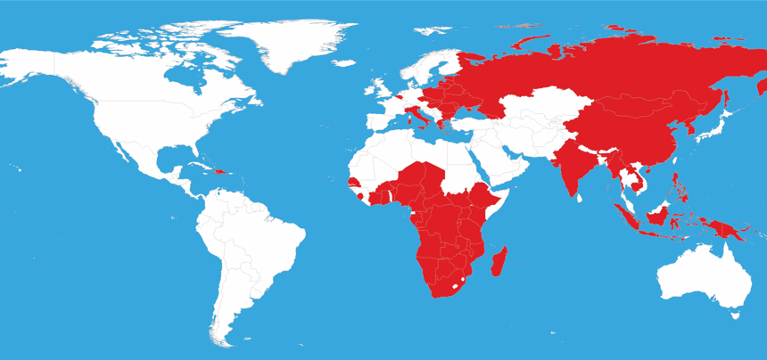
African swine fever
1921
2022

Slide 3
Domestic pig population
Robinson et al., 2014 PLoS One. doi: 10.1371/journal.pone.0096084

Slide 4

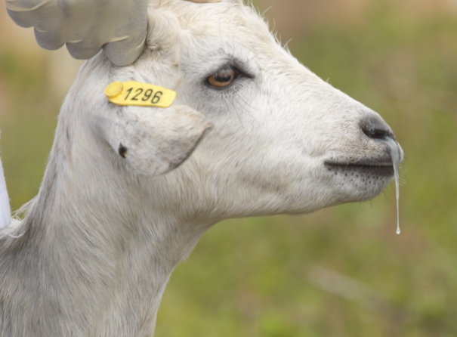
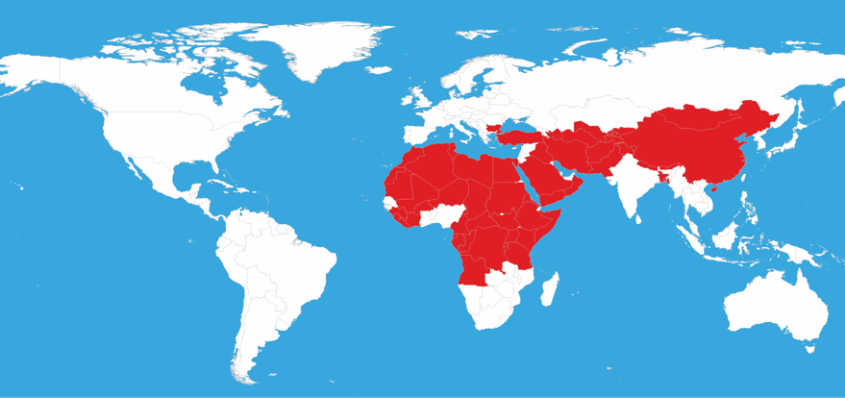
Peste des petits ruminants
1942
2022

Slide 5
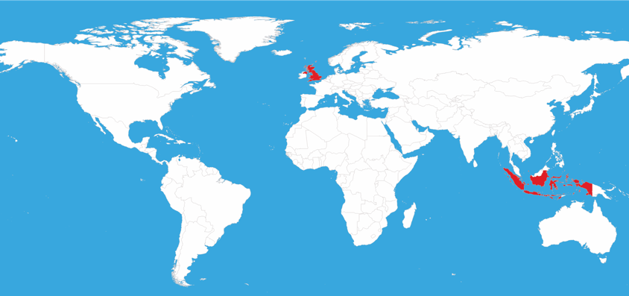
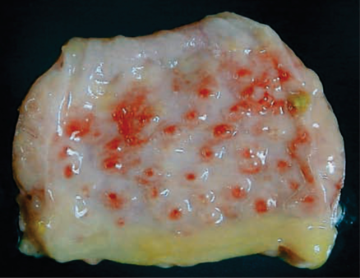
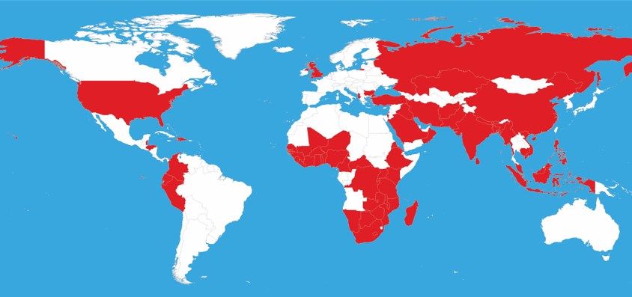
Newcastle Disease
1927
2022

Slide 6
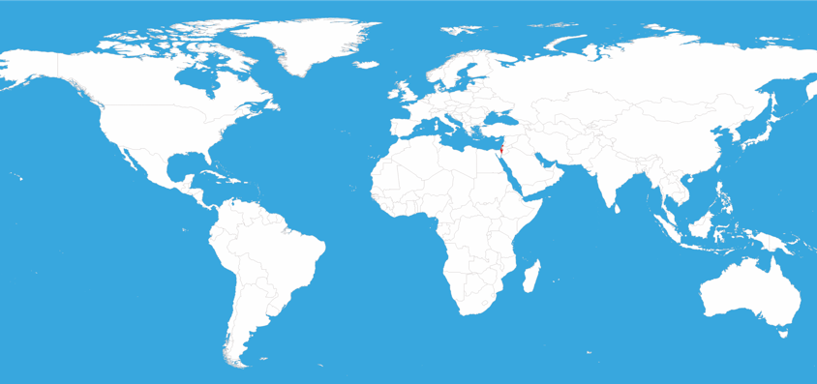
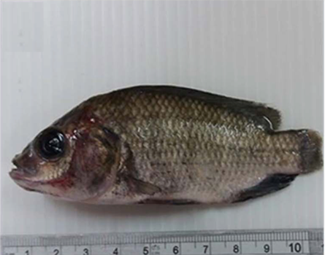
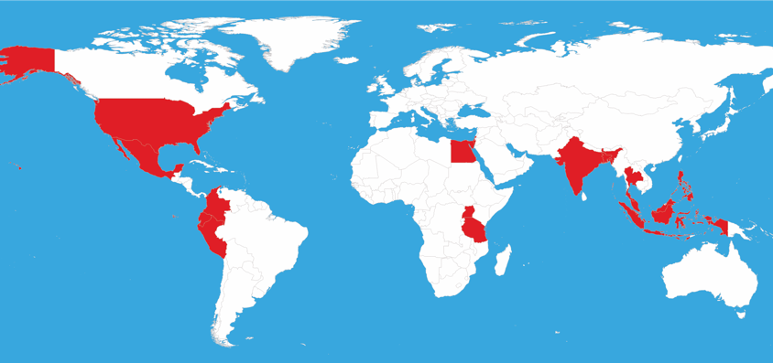
Tilapia Lake Disease
2014
2022

Slide 7

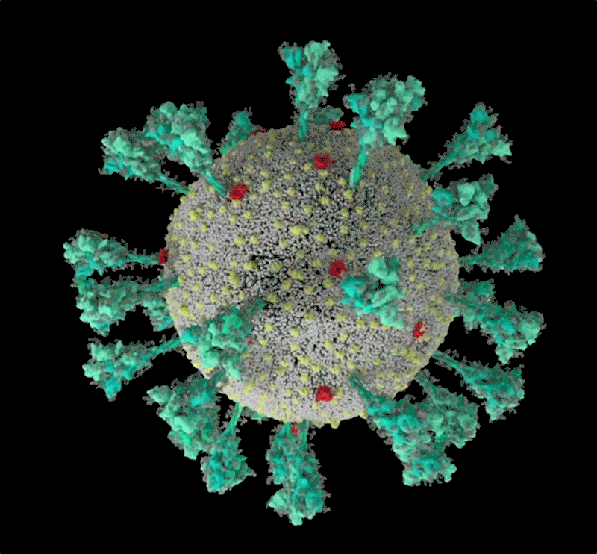
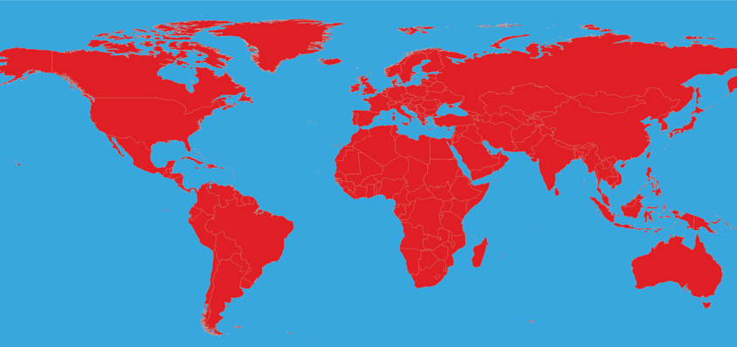
COVID-19
2019
2022

Slide 8
The First 100 Days

Slide 9
The First 100 Days

Slide 10

Disease-free zone
Endemic zone

Slide 11

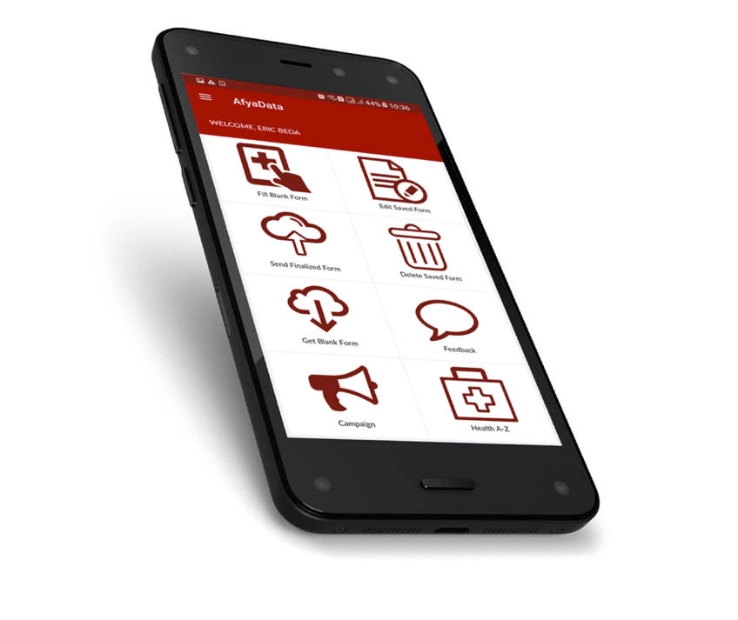

Slide 12
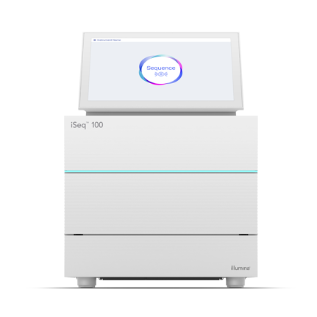

Whole genome sequencing

Slide 13
Genomics Laboratory

Slide 14
Mobile Genomics Laboratory

Slide 15

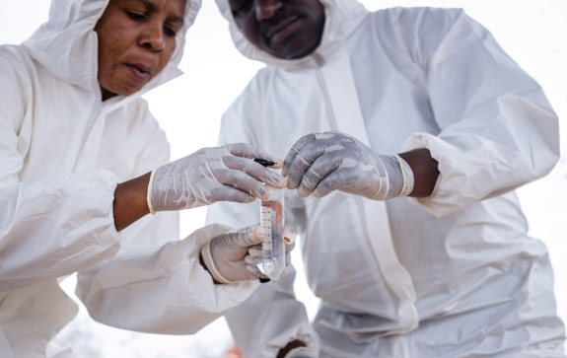
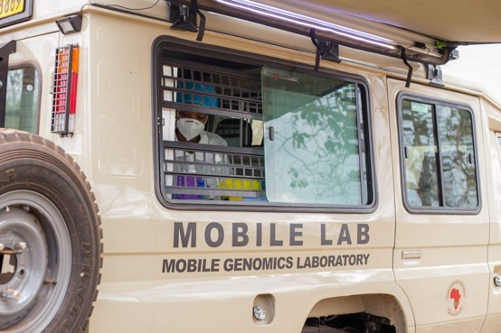
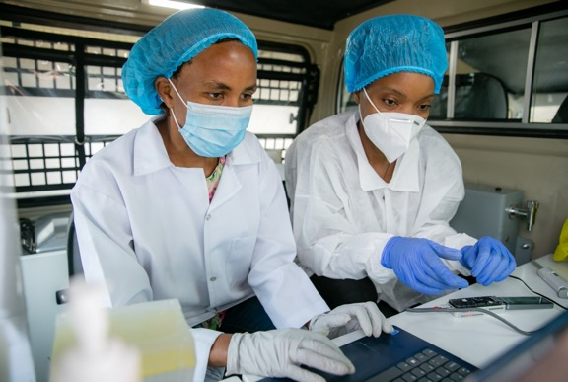
Sequencing in the Field

Slide 17
African swine fever

Slide 18
African swine fever

Slide 19
ASFV complete genome

Slide 20
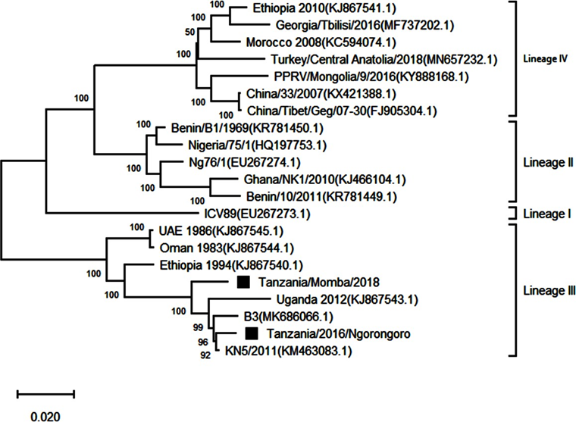
PPRV complete genome

Slide 22
Keeping Outbreaks Localized
Early detection is by far the most achievable and cost-effective way to prevent a threat anywhere in the world from becoming a threat everywhere

Slide 23
Key Challenges for Viral Genomics in Africa
Customs clearance ~ cumbersome procedures
Bioinformatics ~ limited computing capacity and personnel
Connectivity ~ limited bandwidth

Slide 24







Slide 25


